Slide 1
Section 1.8: Bin Packing and Scheduling
Math for Liberal Studies

Slide 2
A “Bin Packing” Problem
There is a list of numbers called “weights”
These numbers represent objects that need to be packed into “bins” with a particular capacity
The goal is to pack the weights into the smallest number of bins possible

Slide 3
Examples
Objects coming down a conveyor belt need to be packed for shipping
A construction plan calls for small boards of various lengths, and you need to know how many long boards to order
Tour groups of various sizes need to be assigned to busses so that the groups are not split up

Slide 4
An Extended Example
Pack the weights 5, 7, 3, 5, 6, 2, 4, 4, 7, and 4 into bins with capacity 10

Slide 5
An Extended Example
Pack the weights 5, 7, 3, 5, 6, 2, 4, 4, 7, and 4 into bins with capacity 10
There are many possible solutions

Slide 6
An Extended Example
Pack the weights 5, 7, 3, 5, 6, 2, 4, 4, 7, and 4 into bins with capacity 10
There are many possible solutions

Slide 7
An Extended Example
Pack the weights 5, 7, 3, 5, 6, 2, 4, 4, 7, and 4 into bins with capacity 10
There are many possible solutions

Slide 8
An Extended Example
Pack the weights 5, 7, 3, 5, 6, 2, 4, 4, 7, and 4 into bins with capacity 10
There are many possible solutions

Slide 9
Setting a Goal
We saw a solution with 5 bins
Is that the best possible solution?
If we add up all the weights, we get 5+7+3+5+6+2+4+4+7+4 = 47
Since our bins have capacity 10, the best we can hope for is 5 bins (5 × 10 = 50)

Slide 10
Leftovers
Take a look at this solution
Notice that some of the bins are exactly full: no leftover space
This is the best way to use a bin

Slide 11
Leftovers
One heuristic method for packing weights is to look for these “best fits”
However, if the list of weights is very long, or if the bin capacity is very large, this can be impractical
Also, sometimes circumstances prevent us from looking at the entire list of weights ahead of time

Slide 12
One-at-a-Time Algorithms
In many packing problems, we have to decide what to do with each weight, in order, before moving on to the next one
Example: Objects coming down a conveyor belt

Slide 13
One-at-a-Time Algorithms
Here are two (there are many more) methods we will consider for deciding which bin to pack the weight into
Look for the first fit. Starting with the first bin, check each bin one at a time until you find a bin that has room for the weight.
Look for the best fit. Consider all of the bins and find the bin that can hold the weight and would have the least room leftover after packing it.

Slide 14
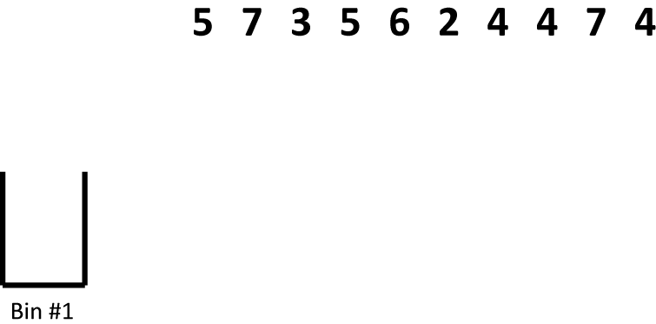
First Fit Algorithm
Let’s try the first fit algorithm on our problem

Slide 15
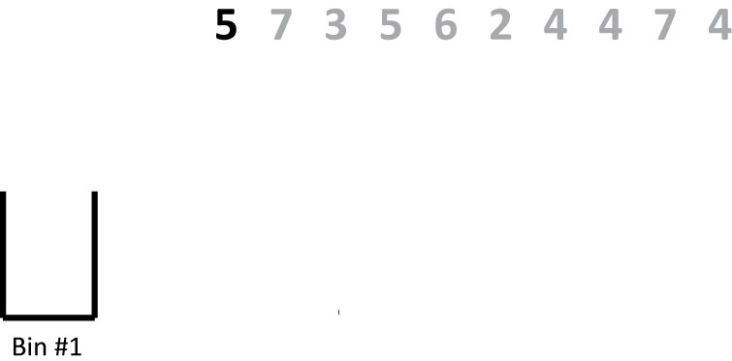
First Fit Algorithm
We’re looking at weights one at a time, so ignore everything but the first weight

Slide 16
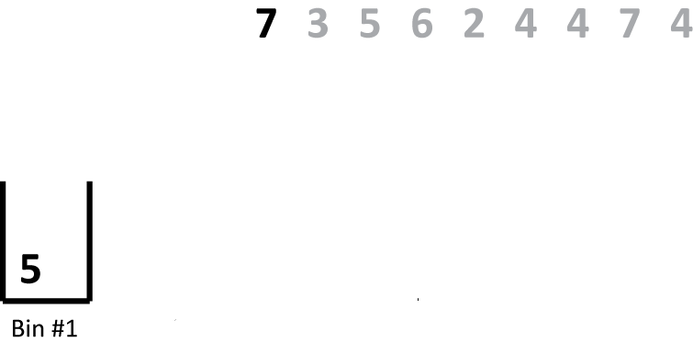
First Fit Algorithm
There is room in the first bin, so we put the 5 in there

Slide 17
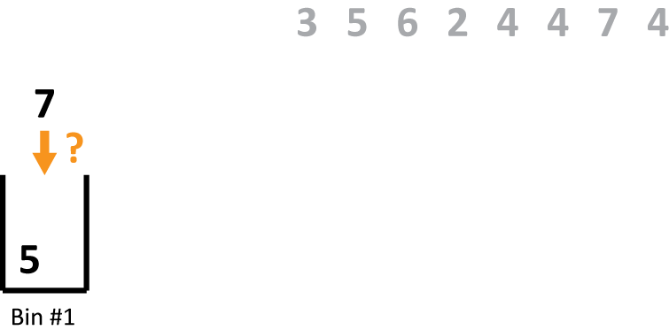
First Fit Algorithm
There is not room for this weight in the first bin, so we create a new bin

Slide 18
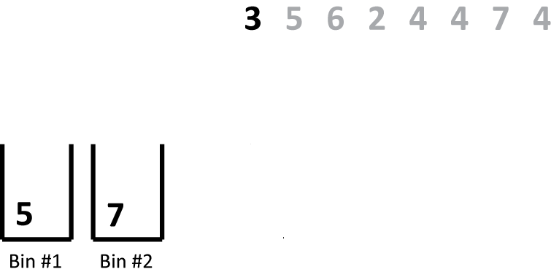
First Fit Algorithm
Now we consider the next weight

Slide 19
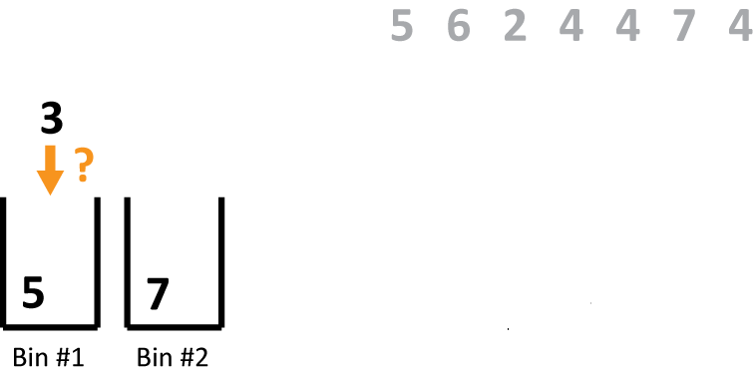
First Fit Algorithm
It fits into the first bin, so that’s where we put it

Slide 20
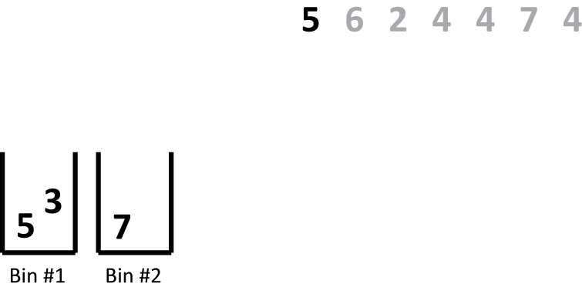
First Fit Algorithm
Now we consider the next weight

Slide 21
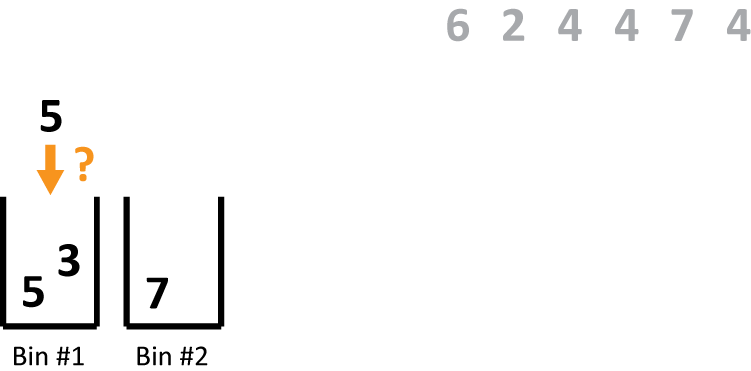
First Fit Algorithm
It doesn’t fit into the first bin…

Slide 22
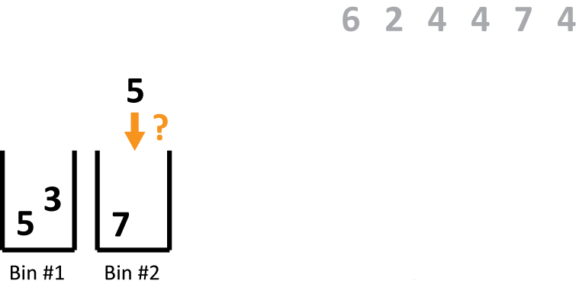
First Fit Algorithm
…or the second bin, so it goes into a new bin

Slide 23
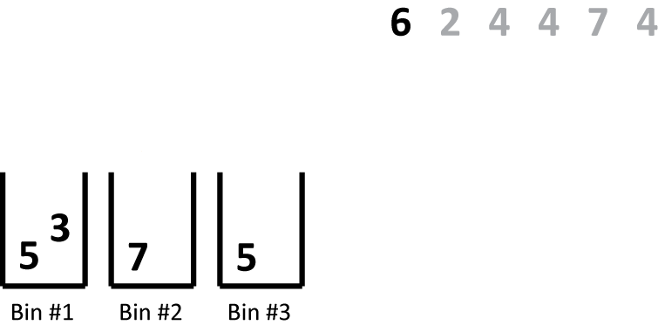
First Fit Algorithm
The next weight doesn’t fit into any of the existing bins, so it goes into a new one

Slide 24
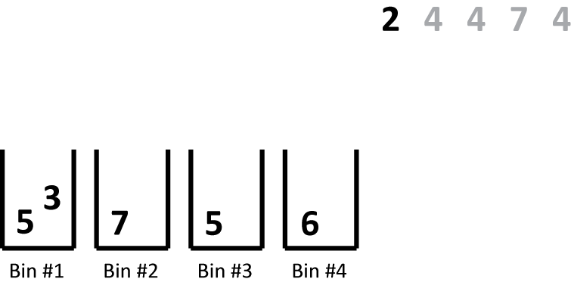
First Fit Algorithm
Now we consider the next weight

Slide 25
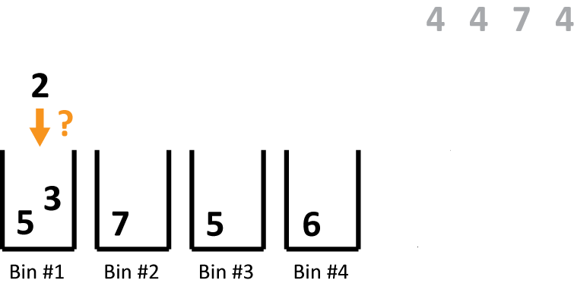
First Fit Algorithm
It fits into the first bin

Slide 26
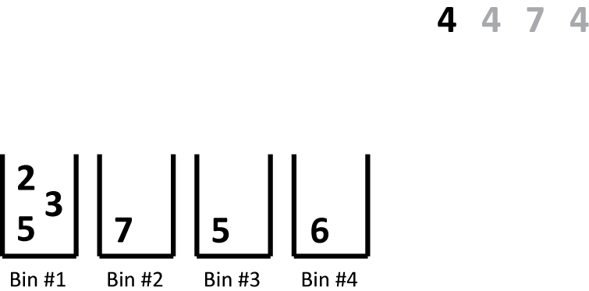
First Fit Algorithm
Now we move on to the next weight

Slide 27
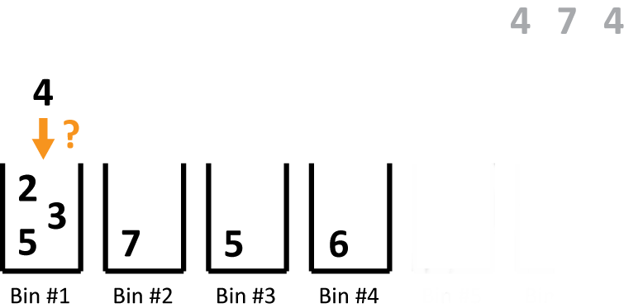
First Fit Algorithm
It doesn’t fit in the first bin…

Slide 28
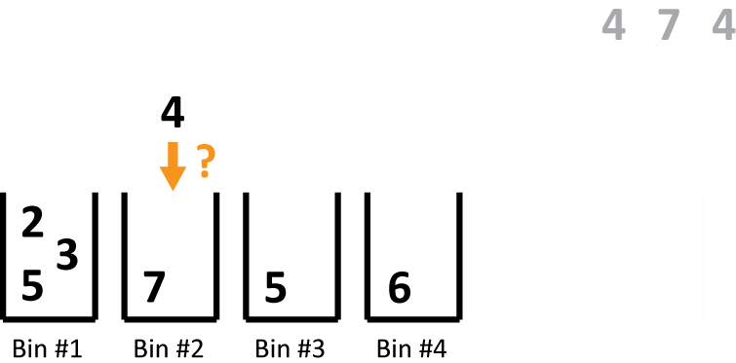
First Fit Algorithm
…or the second bin…

Slide 29
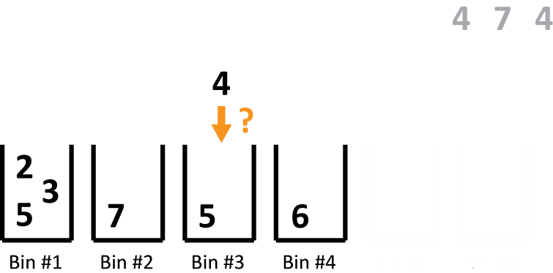
First Fit Algorithm
…but it does fit into the third bin

Slide 30
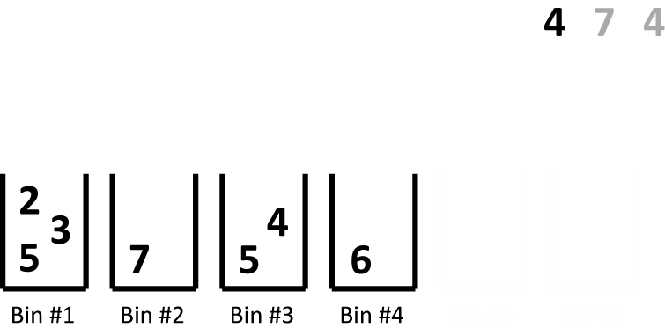
First Fit Algorithm
Similarly, the next weight doesn’t fit into the first three bins, but it does fit into the fourth

Slide 31
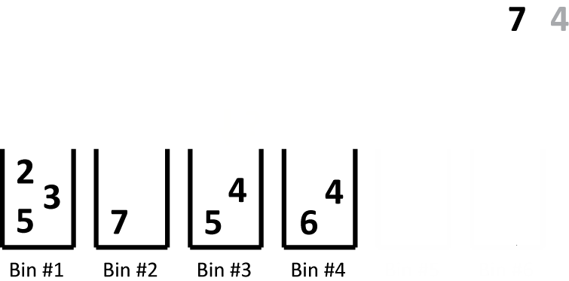
First Fit Algorithm
The next weight doesn’t fit into any of our bins, so we make a 5th bin

Slide 32
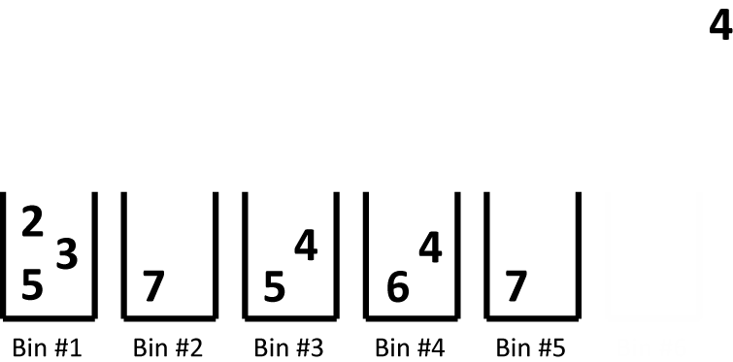
First Fit Algorithm
There is no room for the last weight in any of our bins

Slide 33
First Fit Algorithm
We have finished packing the weights into six bins
But this isn’t the optimal solution!

Slide 34
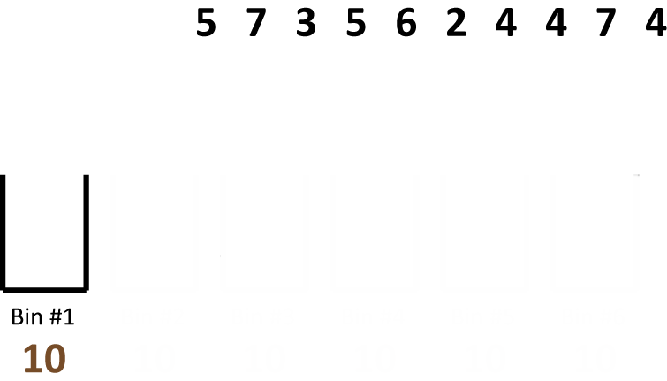
Best Fit Algorithm
Let’s start over and use the best fit algorithm

Slide 35
Best Fit Algorithm
This time we need to keep track of how much room is left in each bin

Slide 36
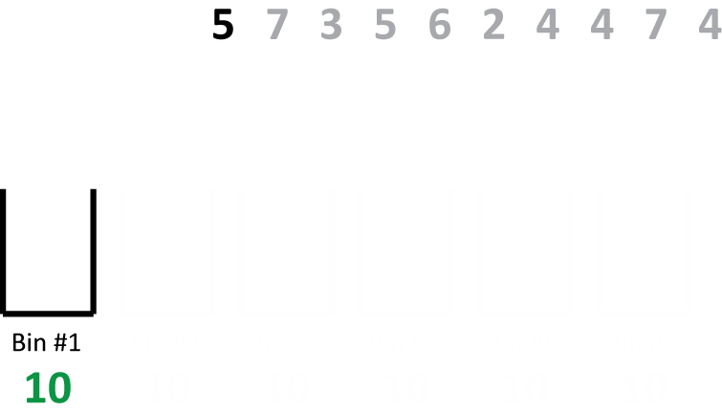
Best Fit Algorithm
When we consider a weight, we look at all the bins that have room for it…

Slide 37
Best Fit Algorithm
…and put it into the bin that will have the least room left over

Slide 38
Best Fit Algorithm
In this case, we only have one bin, so the 5 goes in there

Slide 39
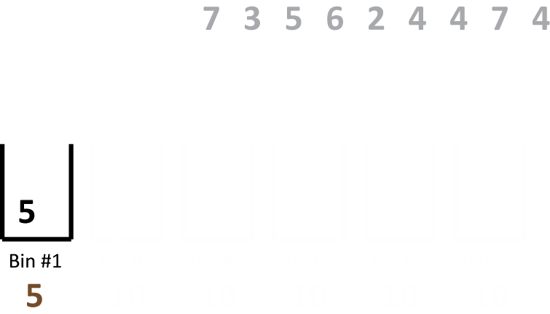
Best Fit Algorithm
In this case, we only have one bin, so the 5 goes in there

Slide 40
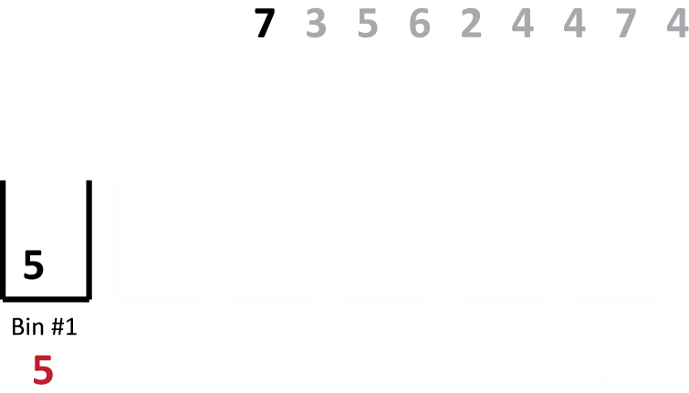
Best Fit Algorithm
For the next weight, we don’t have a bin that has room for it, so we make a new bin

Slide 41
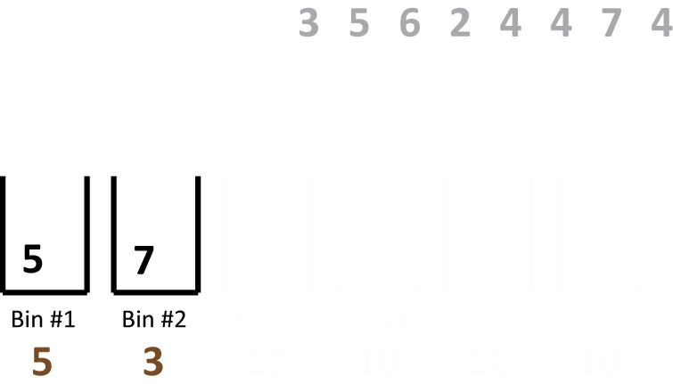
Best Fit Algorithm
Remember, the number under the bin represents how much room is left over

Slide 42
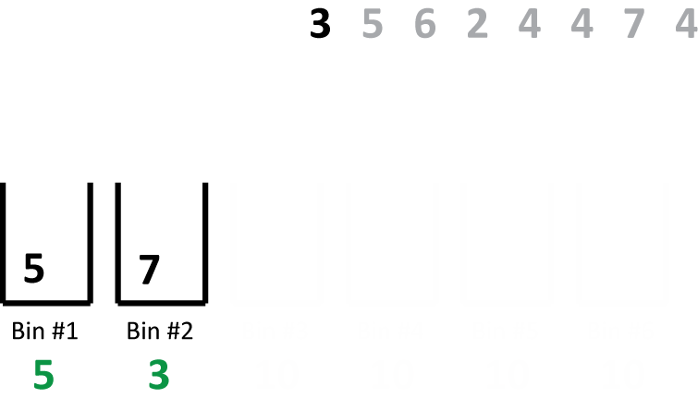
Best Fit Algorithm
Both of our bins have room for the next weight

Slide 43
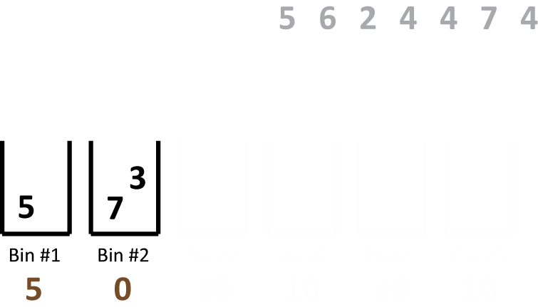
Best Fit Algorithm
Bin #2 has the least room left over, so that’s where we put our weight

Slide 44
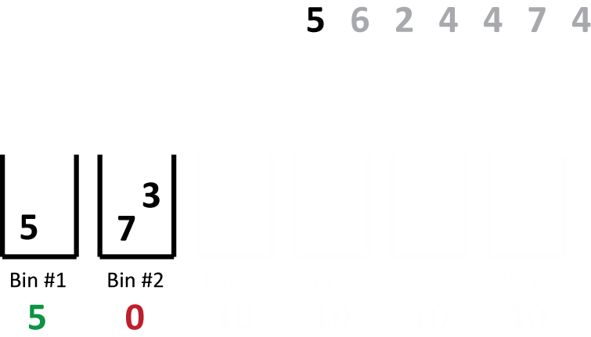
Best Fit Algorithm
Only one bin has room for our next weight, so that’s where it goes

Slide 45
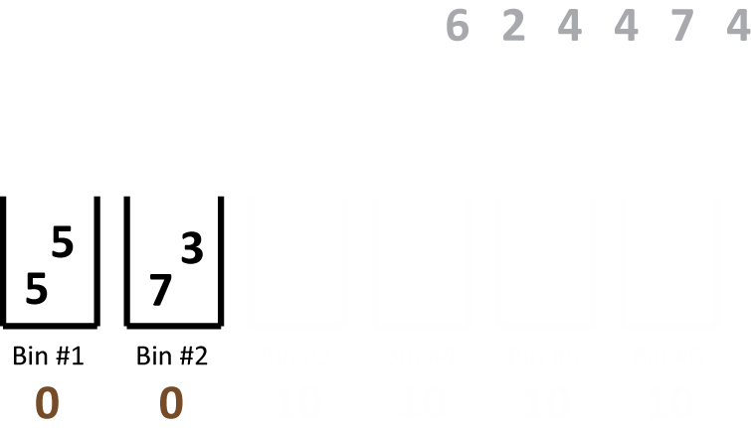
Best Fit Algorithm
Notice that we have two “best fits” now

Slide 46
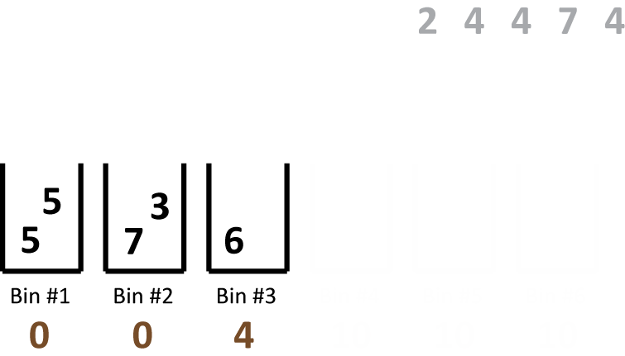
Best Fit Algorithm
Since our two bins are full, the next weight must go into a new bin

Slide 47
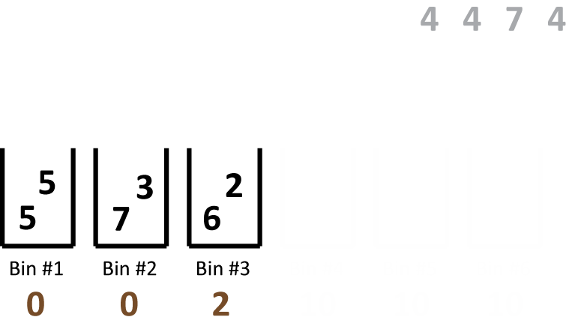
Best Fit Algorithm
The next weight (2) can only go into Bin #3

Slide 48
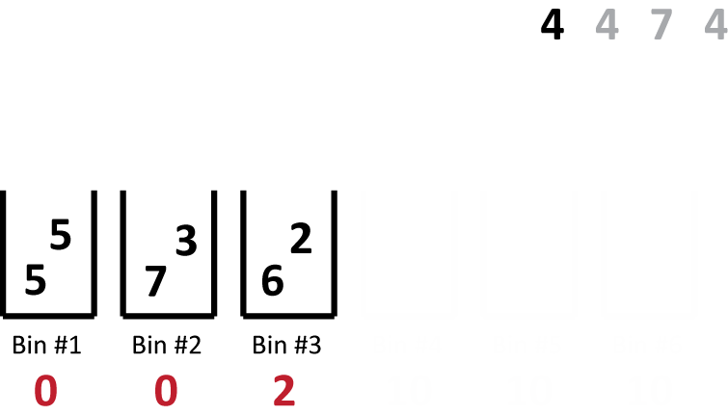
Best Fit Algorithm
This weight doesn’t fit into any of our bins…

Slide 49
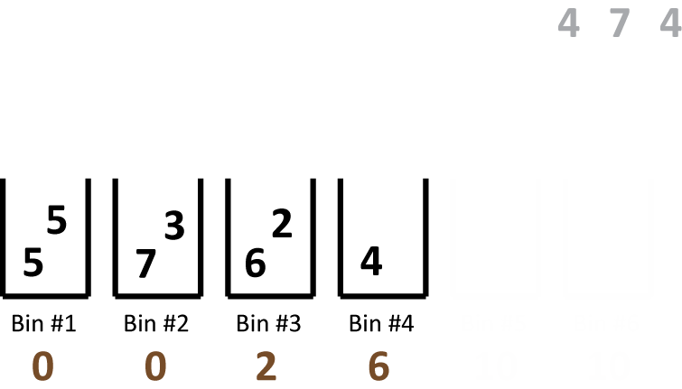
Best Fit Algorithm
…so it goes into a new bin

Slide 50
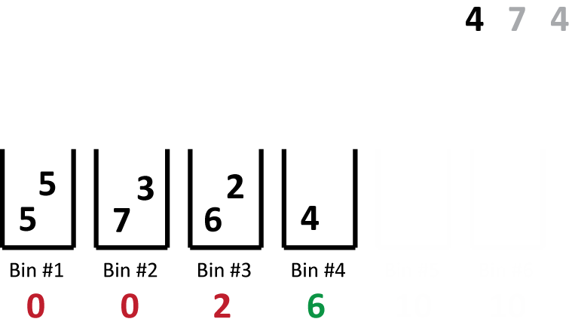
Best Fit Algorithm
This next weight only fits into one bin

Slide 51
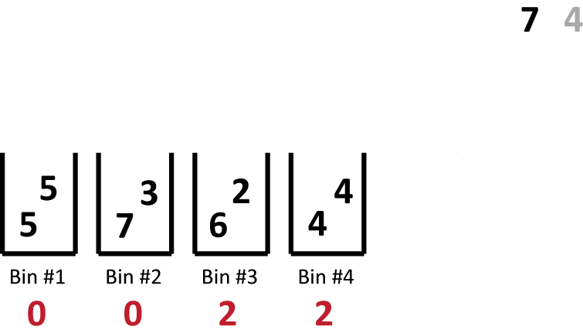
Best Fit Algorithm
This weight must go into a new bin

Slide 52
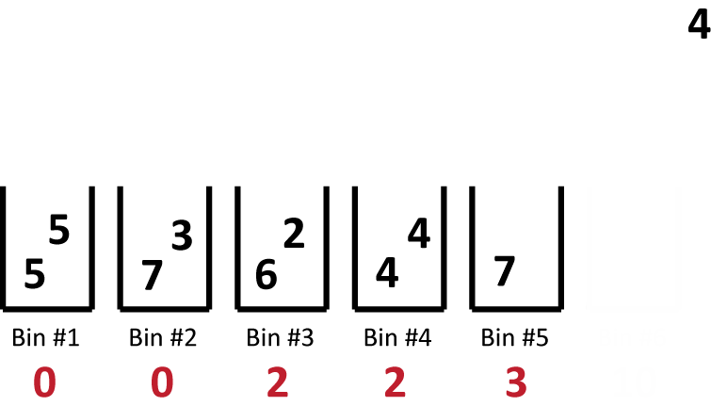
Best Fit Algorithm
The last weight doesn’t fit into any of our bins, so we need to make a sixth bin

Slide 53
Best Fit Algorithm
Here is our final answer, with six bins
This is a different result than the first fit algorithm, but still not the best solution

Slide 54
Looking At the Whole List
One reason why we weren’t finding the best solution is that we had large weights that came late in the list
It’s more efficient to deal with big weights first and fit in smaller weights around them

Slide 55
Two New Algorithms
First fit decreasing: Sort the list of weights from biggest to smallest, then use the first fit method
Best fit decreasing: Sort the list of weights from biggest to smallest, then use the best fit method

Slide 56
Another Application of Bin Packing
Scheduling problems
The weights are tasks that need to be completed
The bins are “processors,” which are the agents (people, machines, teams, etc.) that will actually perform the tasks

Slide 57
Another Application of Bin Packing
Two types of scheduling problems
Type 1: The capacity of the bins represents a deadline by which all tasks must be completed
The number of bins needed represents the number of processors needed to complete all tasks within the deadline

Slide 58
Another Application of Bin Packing
Two types of scheduling problems
Type 1: The capacity of the bins represents a deadline by which all tasks must be completed
We solve this type of problem using normal bin packing methods

Slide 59
Another Application of Bin Packing
Two types of scheduling problems
Type 2: There is a fixed number of bins, but the bins do not have a set capacity
This time the goal is to assign the tasks to processors in such a way that all tasks are completed as soon as possible

Slide 60
We Need a New Method
We can’t use any of the bin packing methods we have learned for this second type of problem, since they rely on “fitting” weights into bins
This time, each bin has an infinite capacity, so any weight “fits” into any bin

Slide 61
Longest Processing Time Algorithm
Sort the task times from largest to smallest
Assign each task, one at a time, to the processor that currently has the least total amount of time assigned to it
If there is a tie, assign the task to the first processor that is tied

Slide 62
An Extended Example
Assign tasks of length 14, 26, 11, 16, 22, 21, 8, and 29 minutes to three processors using the Longest Processing Time algorithm

Slide 63
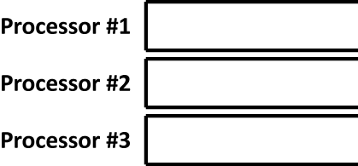
Using the LPT
We know we have three processors, so we draw three spaces to put tasks in

Slide 64
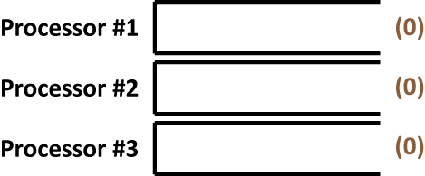
Using the LPT
The algorithm requires us to keep track of how much time has been assigned to each processor

Slide 65
Using the LPT
Now we sort the list of task times in decreasing order:
29, 26, 22, 21, 16, 14, 11, 8

Slide 66
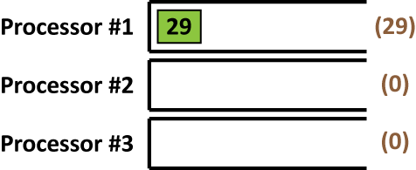
Using the LPT
Since all the processors are tied at 0, we assign the first task (29) to Processor #1
26, 22, 21, 16, 14, 11, 8

Slide 67
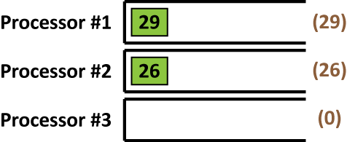
Using the LPT
Now Processors #2 and #3 are tied, so we assign the next task (26) to #2
22, 21, 16, 14, 11, 8

Slide 68
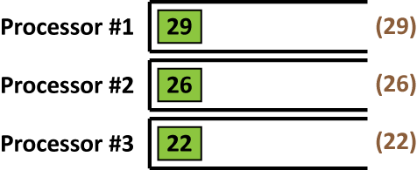
Using the LPT
Next, Processor #3 has the least time assigned to it, so the next task (22) goes there
21, 16, 14, 11, 8

Slide 69
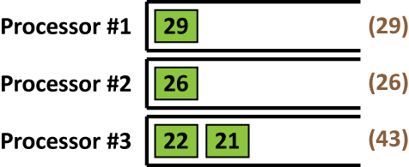
Using the LPT
Again Processor #3 has the least time assigned to it, so the next task (21) goes there
16, 14, 11, 8

Slide 70
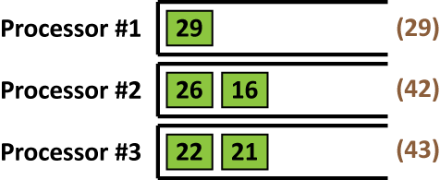
Using the LPT
Now Processor #2 has the least amount of time assigned to it, so that’s where 16 goes
14, 11, 8

Slide 71
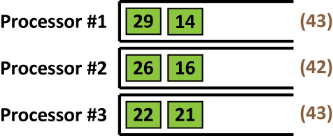
Using the LPT
Next, Processor #1 has the smallest amount of time assigned, so the next task goes there
11, 8

Slide 72
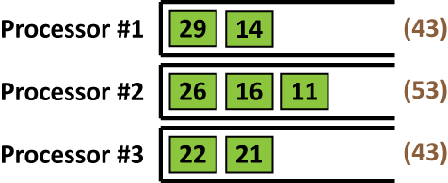
Using the LPT
Now Processor #2 has the lowest total time, so the next task (11) goes there
8

Slide 73
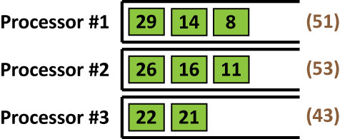
Using the LPT
Finally, Processors #1 and #3 are tied, so we put the next task (8) into the first tied processor

Slide 74
Using the LPT
We are done assigning tasks, and we can see that with this method, all tasks will be complete after 53 minutes

Slide 75
Using the LPT
How good is this answer?
If we add up all the task times, we get: 29+26+22+21+16+14+11+8 = 147 minutes
Since we have 3 processors, we might hope to assign all the tasks so that each processor gets exactly 147/3 = 49 minutes
This might not be possible, but it suggests we might be able to do better than 53

Slide 76
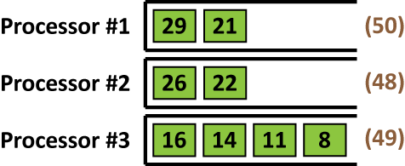
Using the LPT
In fact, we can do better
This shows us that the LPT doesn’t always give the best answer

